Slide 1
Obstacle Detection for Drone Flight Path
Department of Applied Data Science, San Jose State University
DATA 298-B: MSDA Project 1I Dr. Simon Shim

Slide 2
Project Background & Execute Summary
Project Background
Execute Summary
Drones are vital in logistics, agriculture, surveillance, and disaster relief due to their adaptability.
Safe, autonomous navigation is increasingly challenging as drone use expands.
Obstacle intrusions like trees, wires, animals, or other drones can disrupt flight paths.
These cause mission failure, safety risks, or drone damage.
Advanced AI-driven detection systems are essential for safer, more reliable drone operations in real-world settings. .
Goal: Improve drone safety, precision, and responsiveness using AI-based obstacle detection.
Challenge: Complex environments in logistics, infrastructure, and disaster zones require intelligent navigation.
Solution: Use models like YOLOv11, RetinaNet, Faster R-CNN, and RT-DETR to enhance detection accuracy and reduce latency.
Risk Reduction: Minimizes in-flight collisions and navigation errors.
Industry Impact: Enables confident drone deployment in dynamic, real-world scenarios.

Slide 3






Targeted Problem
Research Gap:
Limited focus on aerial intrusions in current literature compared to ground-based object detection.
Unique Challenges:
Aerial obstacles such as ultra-thin wires, small meshes, and tree branches are difficult to detect due to their shape, size, and low contrast.
Dynamic Navigation Needs:
Drones require fast and precise detection systems to avoid mission-critical collisions in complex flight paths.
Focus on DDOS Dataset:
Targets underrepresented aerial obstacle types including thin structures, dense foliage, and small-scale environmental hazards.
Objective:
Bridge the research gap by developing and evaluating advanced detection systems suited for drone navigation in cluttered, real-world aerial environments.
Outcome:
Improve drone safety, autonomy, and reliability in diverse operating conditions.

Slide 4






Deliverables
FRAMEWORK ANALYSIS:
EXPLORES THE CAPABILITIES OF AI MODELS (YOLOV11, RETINANET, FASTER R-CNN, RT-DETR) FOR AERIAL OBSTACLE DETECTION USING DRONE IMAGERY.
DATASET UTILIZATION:
EMPLOYS THE DDOS DATASET TO TRAIN AND VALIDATE MODELS, EMPHASIZING DETECTION OF THIN AND HARD-TO-SEE AERIAL OBSTACLES.
MODEL BENCHMARKING:
COMPARES MODELS USING KEY METRICS SUCH AS MAP, PRECISION, RECALL, IOU, LATENCY, AND ROBUSTNESS UNDER REAL-WORLD DRONE NAVIGATION SCENARIOS.
CODE REPOSITORY:
PROVIDES CLEAN, REPRODUCIBLE CODE FOR TRAINING, INFERENCE, AND EVALUATION TO SUPPORT RESEARCH AND DEPLOYMENT.
TECHNICAL REPORT:
DOCUMENTS METHODOLOGY, RESULTS, PERFORMANCE INSIGHTS TO GUIDE FUTURE IMPROVEMENTS, MODEL ADAPTATIONS.
DEPLOYED MODEL AND WEBSITE:
SHOWCASES THE BEST-PERFORMING MODEL WITH A LIVE WEB INTERFACE FOR INPUT TESTING AND DEMONSTRATION OF REAL-WORLD APPLICATION POTENTIAL.

Slide 5
Literature Survey
1. Obstacle Detection in UAVs
Mavrinac et al., 2020: Highlighted need for lightweight, real-time models for aerial navigation.
Chen et al., 2019 (DOTA Dataset): Stressed importance of object scale, rotation, and class imbalance in aerial imagery.
Yang et al., 2018 (DDOS Dataset): Introduced drone-view dataset covering hard-to-detect objects like wires and poles.
2. CNN-based Object Detection
Redmon et al., 2016 – YOLO: Pioneered real-time detection with single-shot architecture.
Lin et al., 2017 – RetinaNet: Tackled class imbalance using focal loss; proven effective for small objects.
Ren et al., 2015 – Faster R-CNN: Achieved high detection accuracy with RPN + region refinement.
3. Transformer-based Models
Carion et al., 2020 – DETR: Introduced end-to-end object detection using transformers.
Zhang et al., 2023 – RT-DETR: Proposed real-time DETR with hybrid encoder and dense supervision for small object detection.

Slide 6
Technology & Solutions Survey:
Detection Architectures
Model | Strength | Limitation
YOLOv11 | Fastest inference, real-time deployment | Slightly weaker with small or thin objects
RetinaNet | Focal loss handles class imbalance well | Higher latency than YOLO
Faster R-CNN | High spatial accuracy, handles occlusion | Slower, not ideal for edge deployment
RT-DETR | Transformer-based, robust for complex scenes | Requires GPU tuning, moderate inference speed

Slide 7





Technologies Used
Detectron2: High-performance PyTorch framework for R-CNNs and RetinaNet
Hugging Face + PyTorch: Used for RT-DETR with support for pretrained models
Google Cloud Platform (GCP): Model training, data storage, and GPU-based inference
Streamlit + Hugging Face Spaces: Lightweight UI for demo and real-time interaction
Apache Beam & Cloud Composer: For data preprocessing and orchestration

Slide 8
Dataset
The Drone Depth and Obstacle Segmentation (DDOS) dataset comprises synthetic aerial images captured by drones, along with corresponding depth maps and pixel-wise semantic segmentation masks.
It was introduced in the research paper titled "DDOS: A Synthetic Dataset for Drone Detection and Obstacle Segmentation," authored by Benedikt Kolb from the Technical University of Munich
DDOS is purpose-built to support research and development in computer vision, focusing on tasks such as depth estimation and obstacle segmentation from aerial imagery.
Emphasizing the detection of thin structures like wires and effective navigation in diverse weather conditions, DDOS serves as a valuable resource for advancing algorithms in autonomous drone technology.
Structure and Data Splits:
Training Set: 300 flights, totaling 30k images.
Validation Set: 20 flights, totaling 2k images.
Test Set: 20 flights, totaling 2k images.

Slide 9
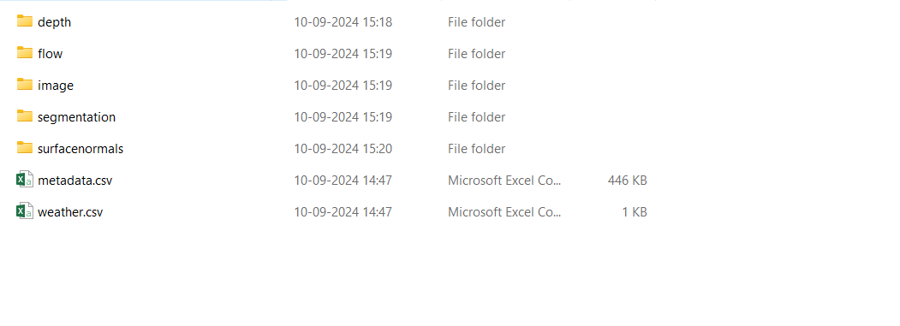
Dataset
Environments and Flights:
Data is captured over Neighbourhood (urban, residential) and Park (natural, park-like) settings. Each environment contains multiple flights, each represented by a unique ID, with images and corresponding data organized by type (e.g., depth, flow).
Data Types for Each Flight:
RGB Images: Captured by drone cameras.
Depth Maps: Represent object distances, saved as uint16 PNGs, encoding distances up to 100 meters.
Segmentation Masks: Pixel-wise annotations for semantic segmentation, with key obstacle categories mapped to specific values.
Optical Flow: Depicts the motion of objects between frames.
Surface Normals: Maps representing the orientation of surfaces.

Slide 10
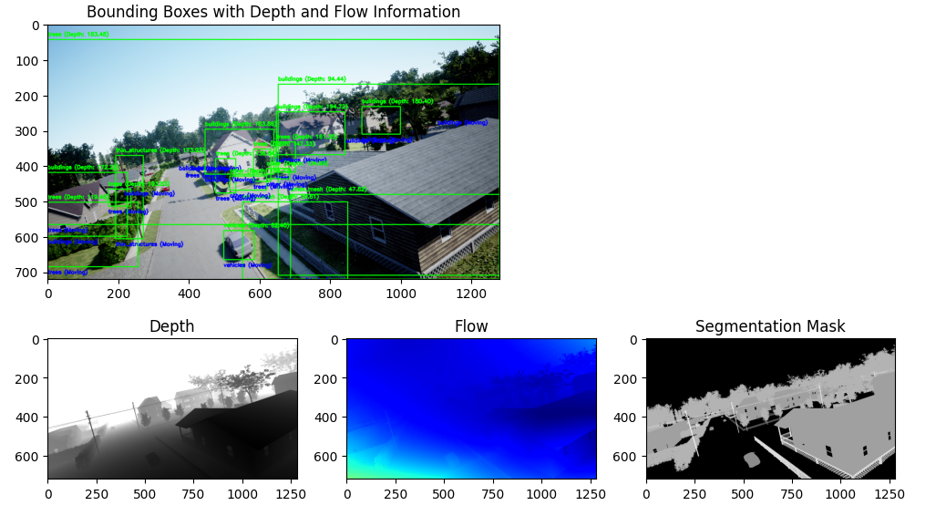
Dataset
Segmentation Class Mapping:
Ultra Thin (255),
Thin Structures (240),
Small Mesh (220),
Large Mesh (200),
Trees (180),
Buildings (160),
Vehicles (140),
Animals (100),
Other (80)
Metadata Files: Contain detailed contextual information about each flight, including coordinates, drone pose, acceleration, weather conditions, and camera parameters.
Weather Data: Environmental conditions during flights are also recorded.
Dataset Usage Guidelines:The dataset is structured for use with deep learning frameworks like PyTorch.Respect the data splits, keeping training, validation, and testing sets separate for accurate model assessment.
The DDOS dataset is 256 GB in size.resource

Slide 11
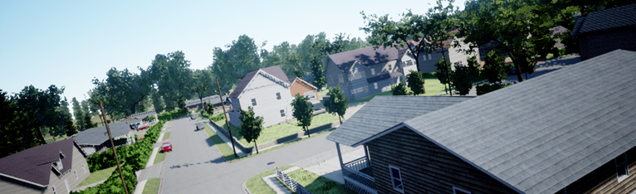
Dataset Pre-Processing
Dataset: DDOS (Drone Depth and Obstacle Segmentation).
Covers urban neighborhoods and parks.
Includes RGB images, depth maps, segmentation masks, and metadata.
Preprocessing:
Image resizing to 224x224 pixels.
Data augmentation: Rotation, brightness adjustment, noise addition.
Normalization of pixel values for consistent analysis.
Splits:
Training: 30,000 images from 300 flights.
Validation and Testing: 2,000 images each from 20 flights.

Slide 12
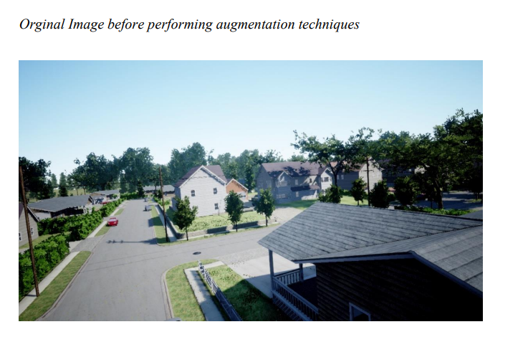
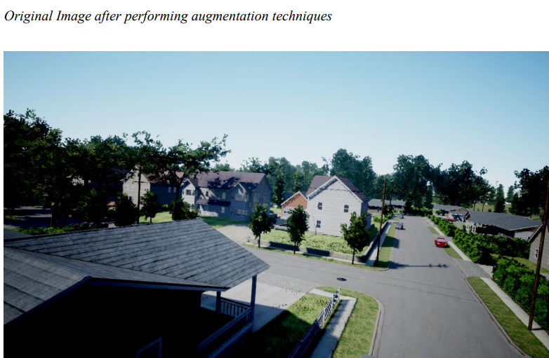
Data Augmentation

Slide 13


Prepared Data Statistics
Big Data Insights:
Comprehensive metadata for flight parameters (e.g., position, velocity, weather conditions).
Data stored in Google Cloud BigQuery for efficient querying.
Statistics:
Flight scenarios include urban and park environments.
Heatmaps, boxplots, and histograms reveal data distribution and correlations.
Visualization:
Diverse data types ensure robust model training and evaluation.

Slide 14
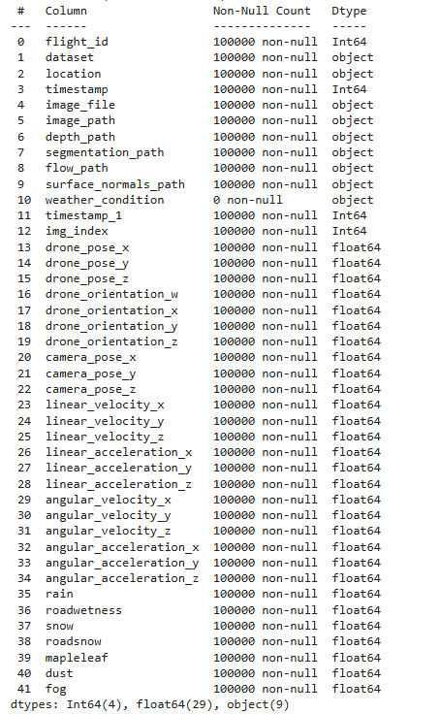
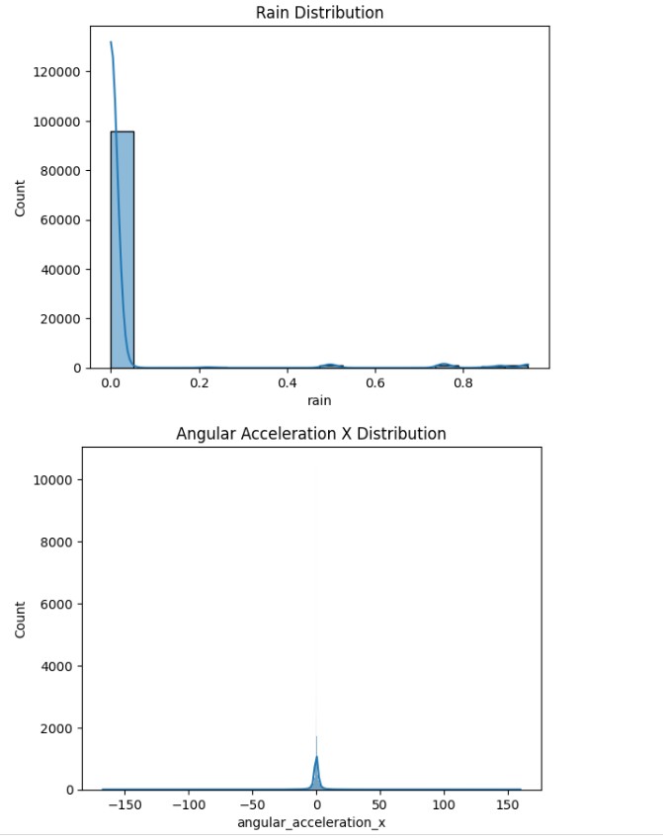
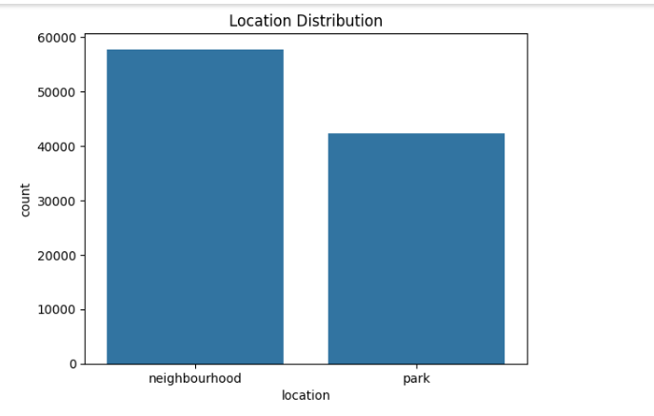
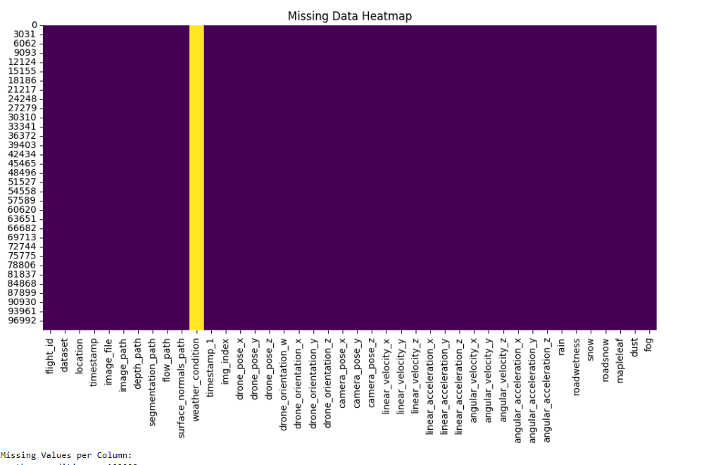
Visualizations

Slide 15
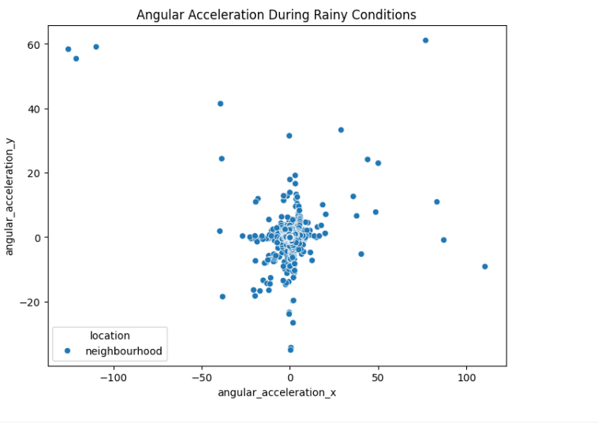
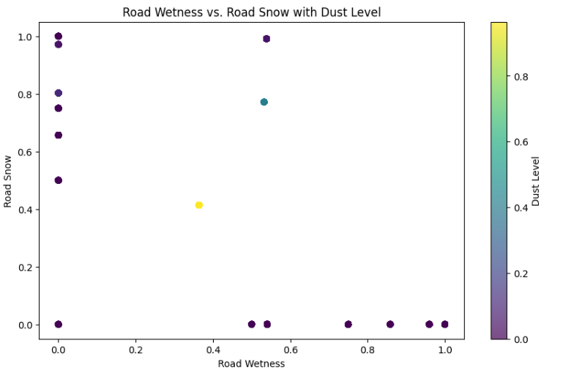
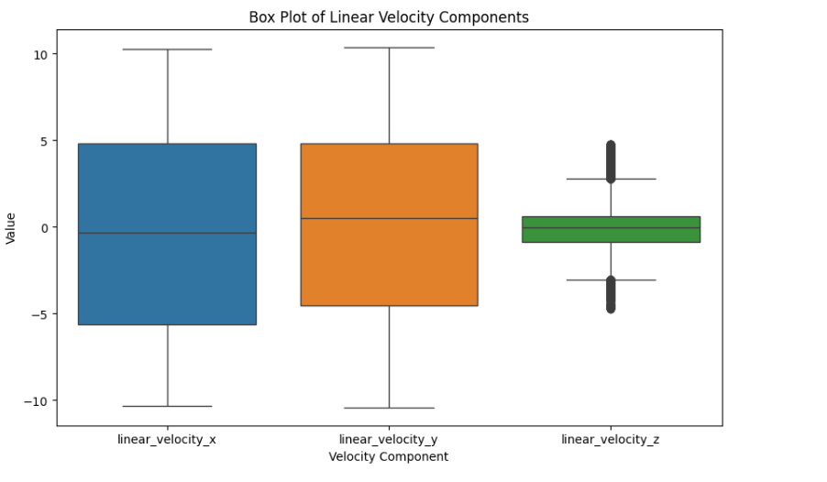
Visualizations

Slide 16
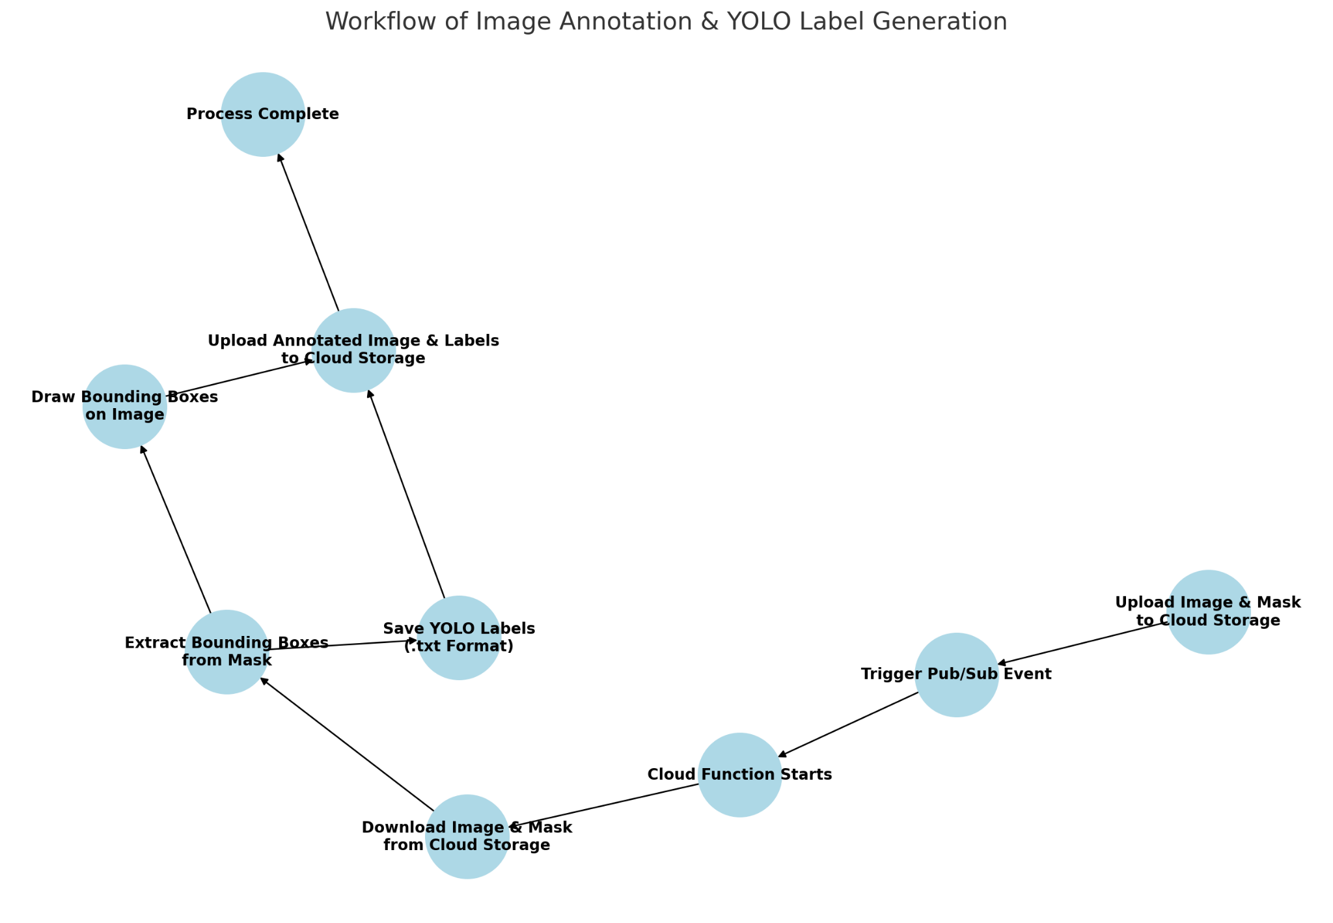
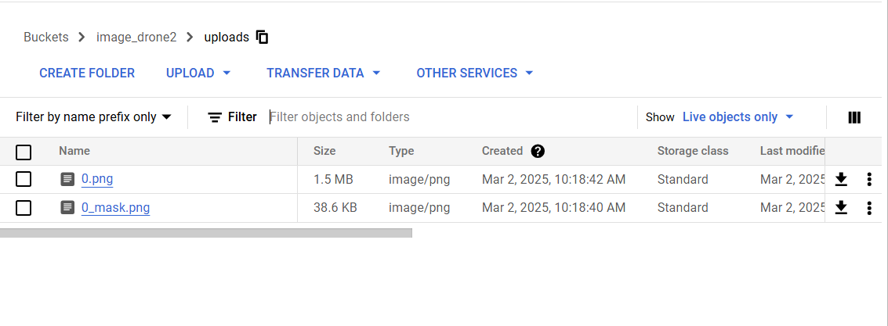
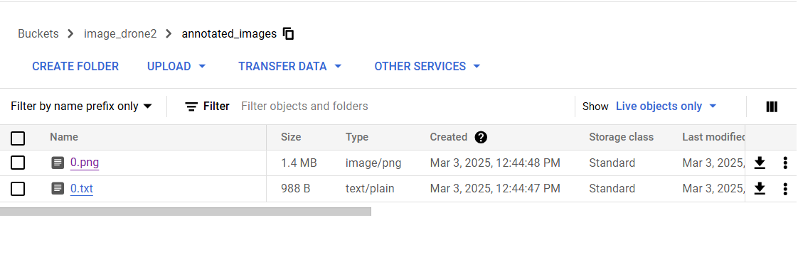
Pipeline for annotations

Slide 17
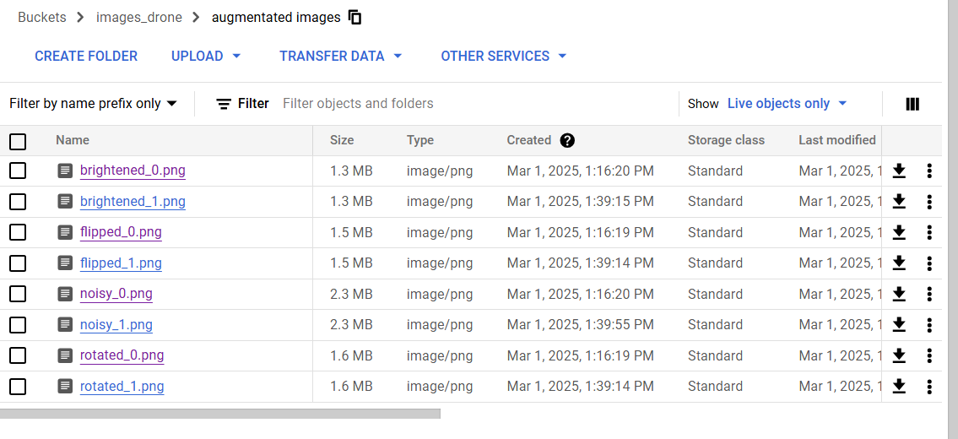
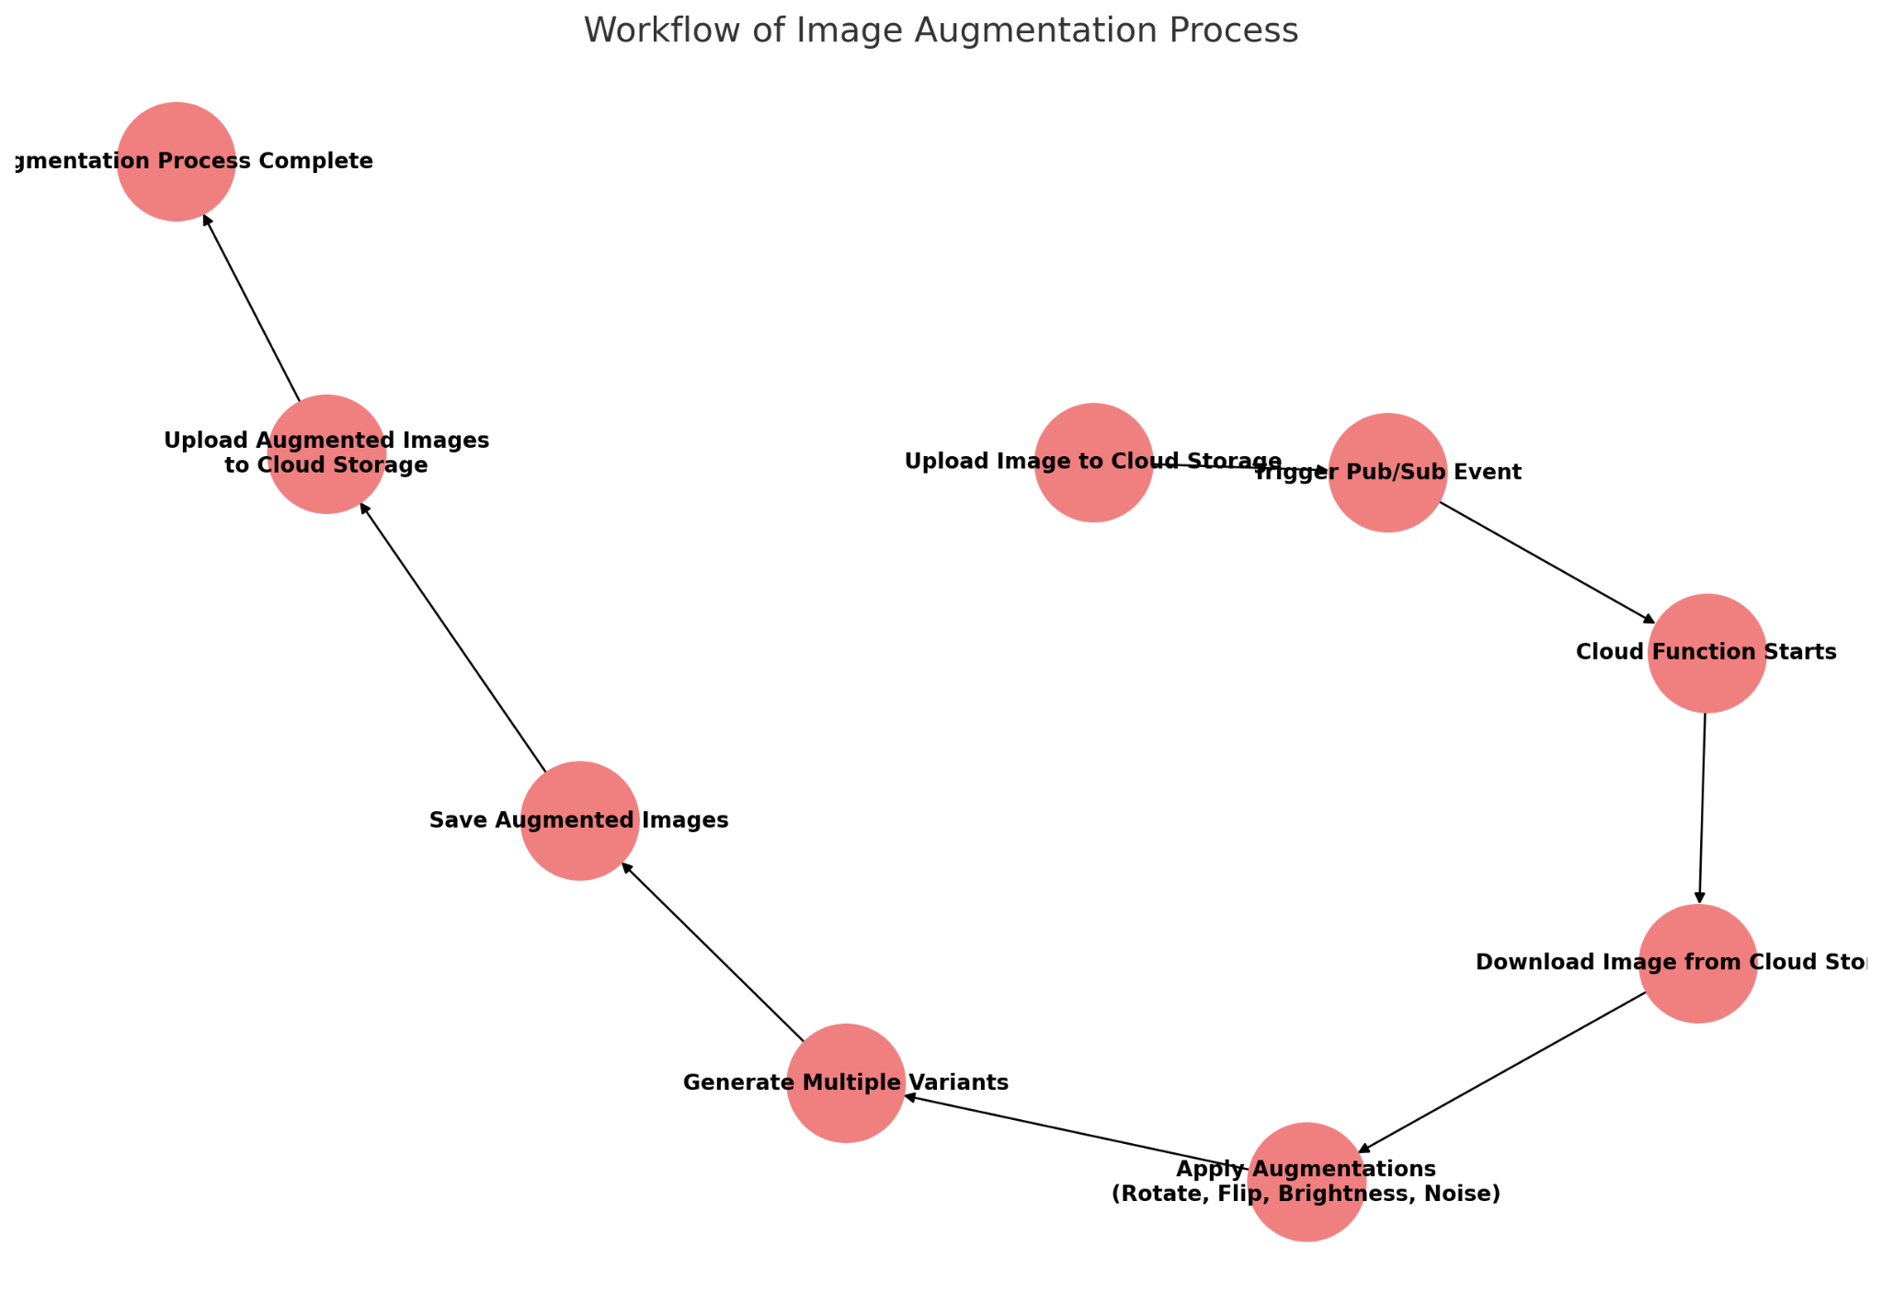
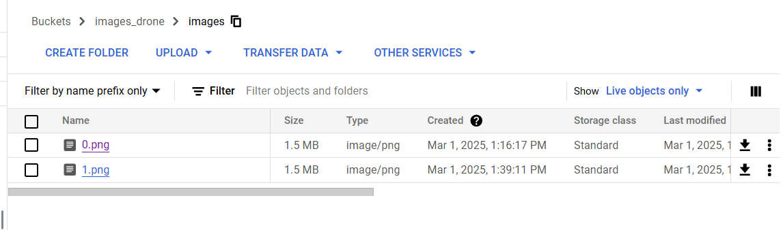
Pipeline for Augmentation

Slide 18
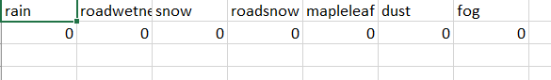
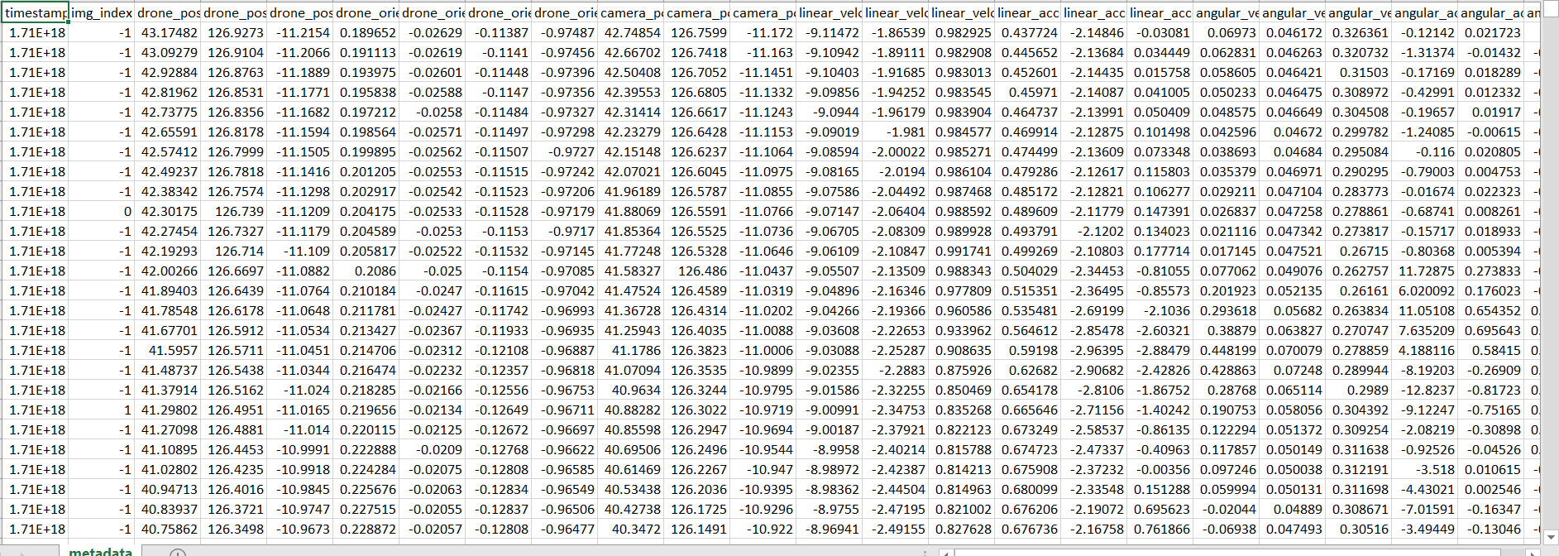
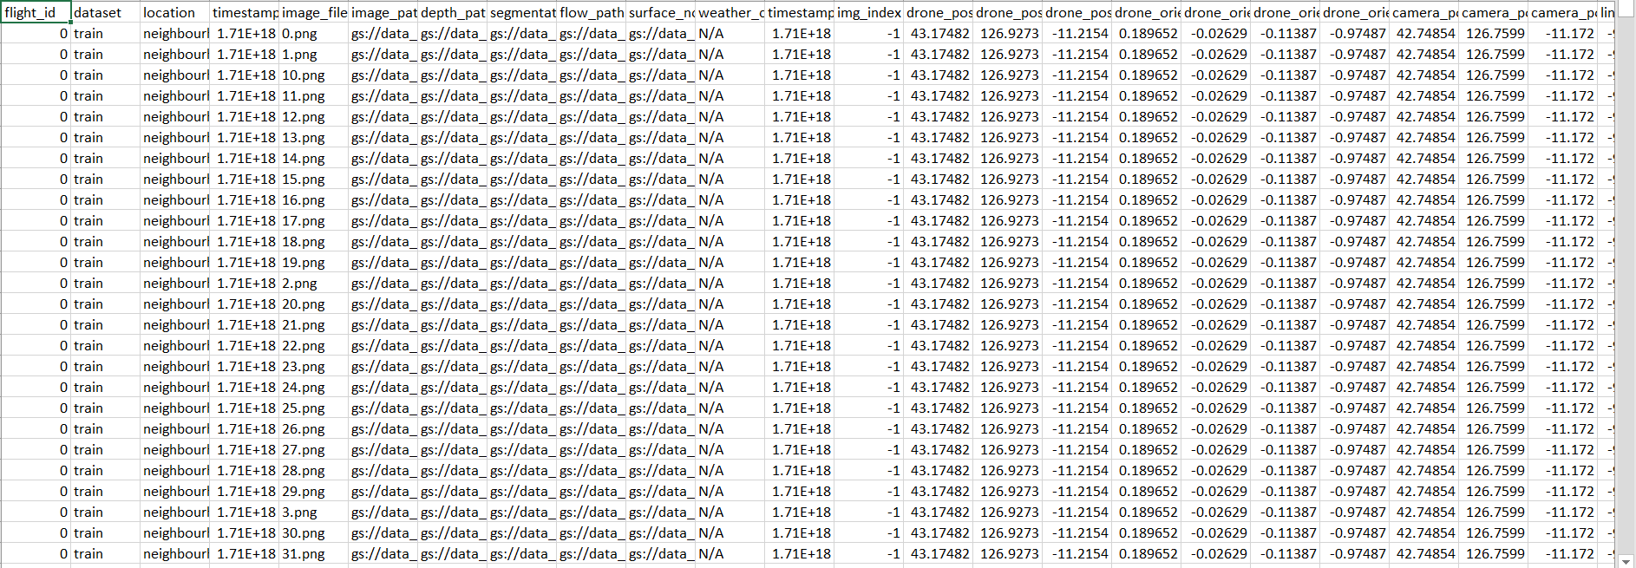
Pre and Post Processing
Pre-Processing
Post-Processing

Slide 19
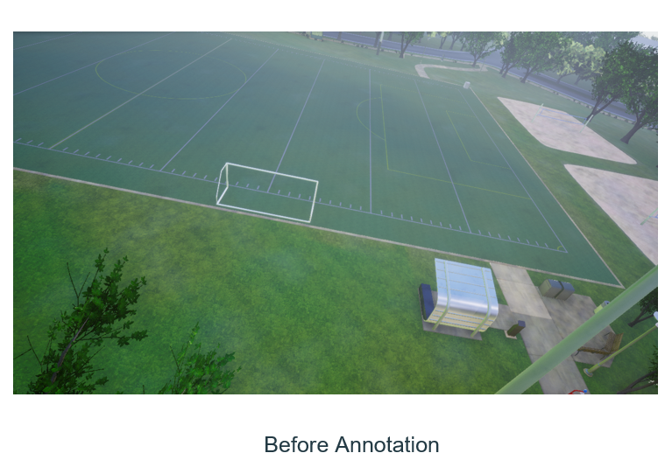
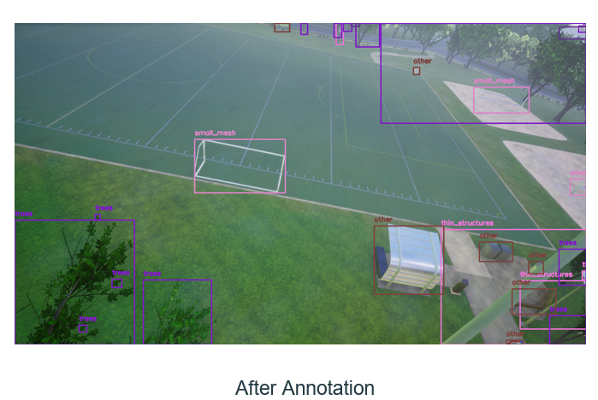
Annotations
The above images show annotations applied to a field scene, highlighting objects like trees, small meshes, thin structures, and other obstacles using bounding boxes for object detection tasks.

Slide 20
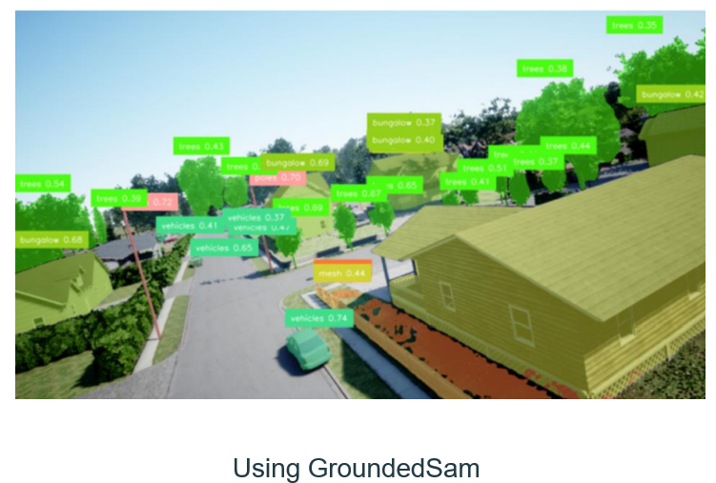
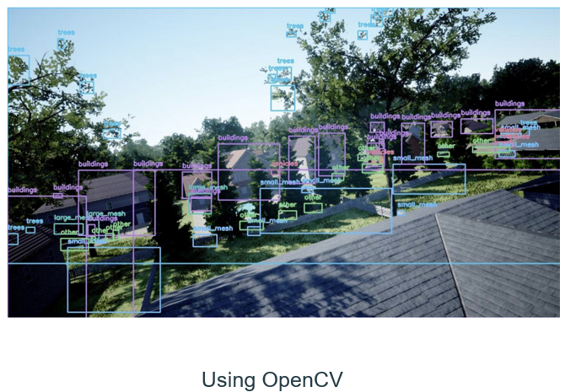
Image after performing annotation

Slide 21
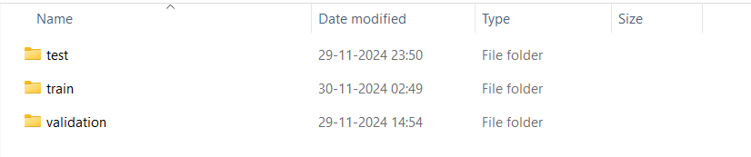
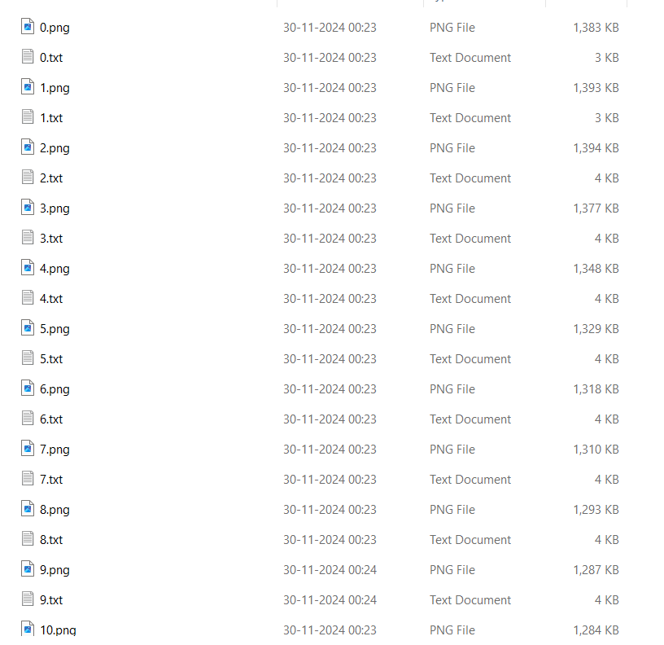
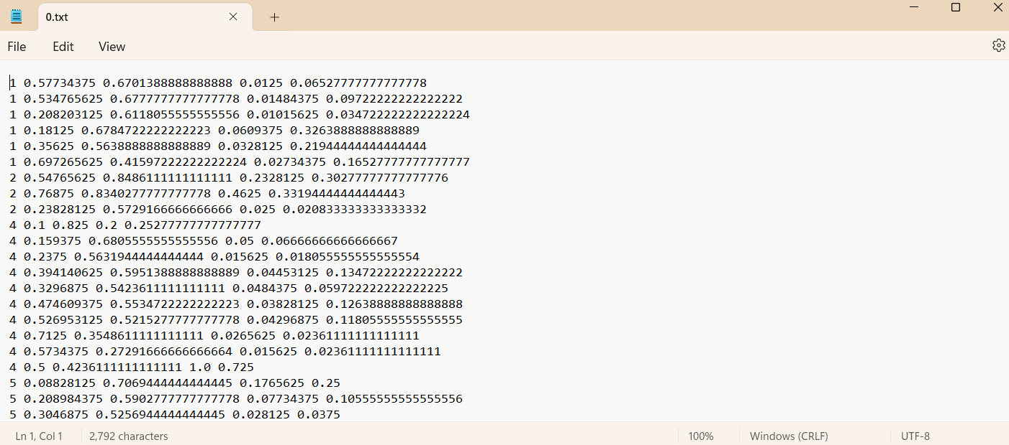
Dataset Formatting & Organization

Slide 22
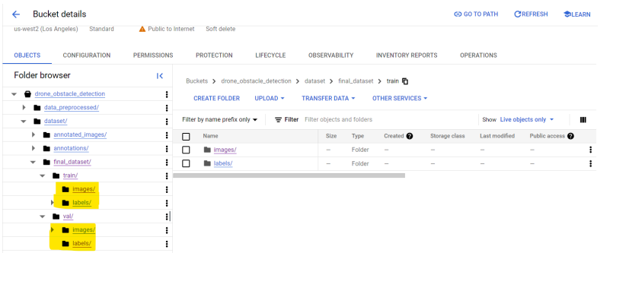
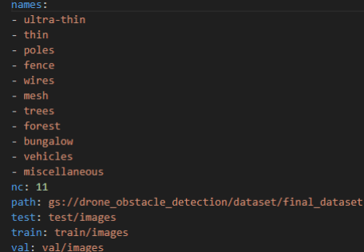
Dataset Organization & Configuration
The first image shows a Google Cloud Storage bucket structure for a drone obstacle detection project, organizing the dataset into folders for training, validation, and testing, each containing subfolders for images and labels.
The second image displays a configuration file defining the class labels (e.g., ultra-thin, poles, trees, vehicles) and specifying the paths for train, validation, and test datasets, stored in the Google Cloud bucket.

Slide 23
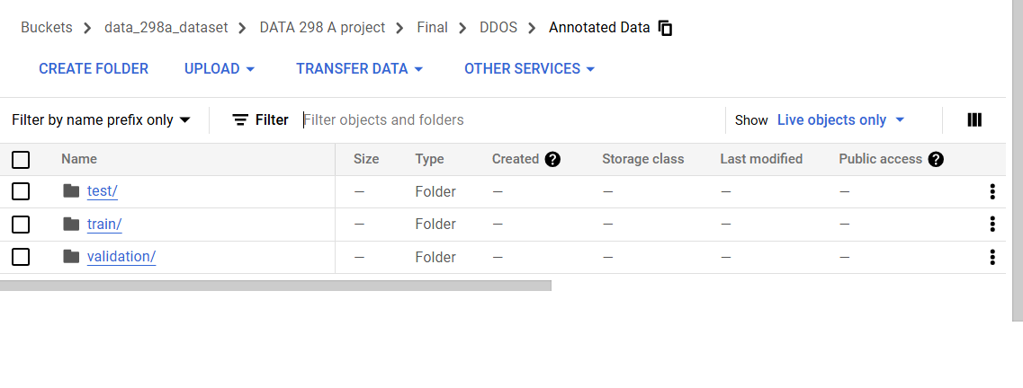
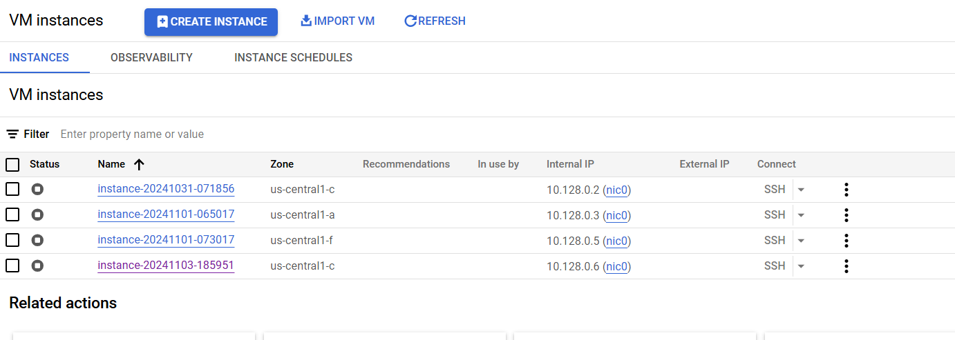
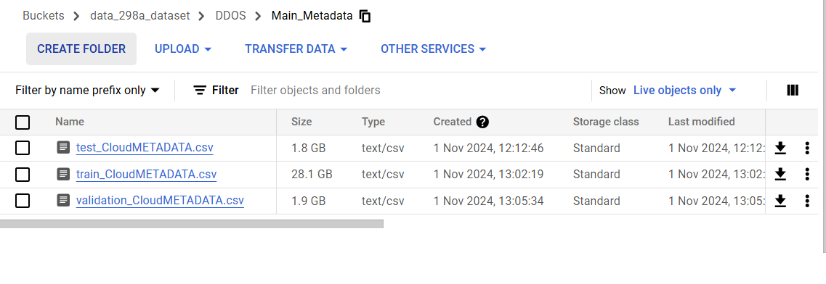
Dataset Management

Slide 24





Data Pipeline
Data Ingestion
Annotation
Preprocessing
Transformation
Model Training & Deployment
Captures imagery and metadata from drones
Stored securely in Google Cloud Storage
Uses SAM (Segment Anything Model) and manual validation for bounding box creation
Ensures precise labeling and consistent object class annotation
Resizing, normalizing, and augmenting input data
Applies structured transformations to prepare data for training
Utilizes Apache Beam for scalable data processing
Data pipelines managed through Cloud Composer for orchestration
Preprocessed data fed into ML models
Enables a real-time obstacle detection system
Supports high-speed, accurate drone navigation in dynamic environments

Slide 25
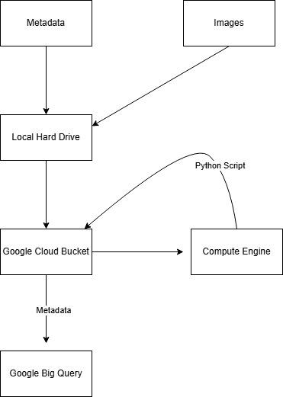
Data Processing & Workflow Architecture

Slide 26
Workflow
Interface Initialization
Resource Loading
Input Selection (Sidebar)
File Upload
Temporary File Handling
YOLO Inference
Visual Output
Detection Report
Live Camera Mode

Slide 27
Workflow
1) Interface Initialization:The application launches with a descriptive page title and an orderly, user‑friendly layout.
2) Core Resource Loading YOLO Model — the pretrained object‑detection engine is loaded into memory. OpenAI Credentials — an API key is registered to enable GPT‑powered textual summaries.
3) Input‑Source Selection (Sidebar) Upload files — permits submission of local images or videos. Webcam (real‑time) — enables continuous streaming from the client’s camera.
4) Upload Workflow (when Upload files is chosen) The user clicks Browse and selects one or more files in supported formats (.jpg, .png, .mp4, etc.). Each selected file is temporarily retained in Streamlit’s in‑memory buffer, pending further processing.
5) Temporary File Creation: Upon receipt, each uploaded asset is written to a secure, system‑generated temporary file.This disk‑based copy provides an absolute file path required by the YOLO inference engine.he temporary artefact is programmatically deleted immediately after processing to preserve storage hygiene.
6) Model Inference (YOLO)Images: The complete image is analysed once; bounding boxes are produced for every detected obstacle.Video assets: To optimise throughput, only every third frame is evaluated; the first sixty annotated frames are surfaced for user review.
7) Visual Feedback Pipeline: The unaltered source media is presented to the user first for baseline comparison.A second rendering follows, displaying YOLO’s annotations—bounding boxes and class labels—in an easily interpretable overlay.
8) Detection Report Generation: For each processed file, the application compiles a concise report enumerating:Class names of detected objects (e.g., wire, pole).Confidence scores expressed as decimals (e.g., 0.87 = 87 % certainty).
9) Live‑Camera Workflow Selecting: Start webcam grants camera permission and initiates continuous frame capture.YOLO processes every incoming frame in real time, superimposing bounding boxes to create an immediate, interactive overlay.

Slide 28
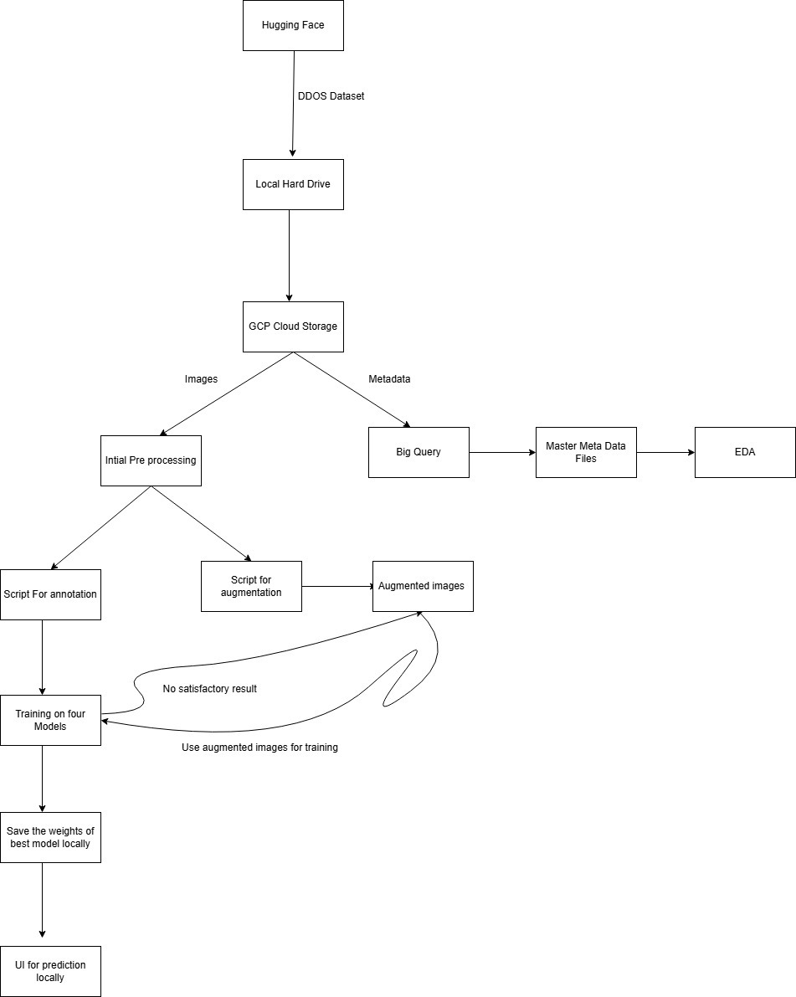
Project High Level View

Slide 29




Machine Learning Models
YOLOv11
RetinaNet (Detectron2)
Faster R-CNN (Detectron2)
RT-DETR (HF)
Real-time, single-stage object detection model optimized for speed and low latency, ideal for real-time drone navigation and fast obstacle response.
One-stage detector with focal loss, providing a balance of accuracy and efficiency. Well-suited for detecting obstacles of varying sizes in urban and semi-structured environments.
High-accuracy two-stage object detection model effective at identifying small, overlapping, and occluded objects, making it suitable for complex aerial scenes.
Transformer-based end-to-end detection model that uses attention mechanisms for fine-grained obstacle localization. Performs well in visually dense or cluttered environments while maintaining real-time inference capability.

Slide 30
Justification for Model Selection
YOLOv11
Real-Time Detection: Ideal for drones requiring fast and low-latency obstacle processing.
Efficiency: Combines high detection speed with solid accuracy for dynamic environments.
Lightweight: Well-suited for edge deployment on drones and embedded systems.
RetinaNet (Detectron2)
Focal Loss Advantage: Handles class imbalance effectively, especially for small/thin objects.
Balanced Performance: Offers a strong trade-off between detection accuracy and computational efficiency.
Urban Reliability: Performs well in structured and semi-structured environments like roads and parks.
Faster R-CNN (Detectron2)
High Precision: Excels in detecting small, overlapping, and occluded objects.
Spatial Accuracy: Strong region proposal strategy supports detailed localization.
Cluttered Scene Robustness: Reliable in dense, complex aerial imagery.
RT-DETR (HF)
Transformer-Based Detection: Enables contextual reasoning and robust object matching.
End-to-End Architecture: Eliminates post-processing steps like NMS for streamlined inference.
Dynamic Scene Handling: Maintains precision in visually complex or cluttered environments.

Slide 31
Model Comparison
Model | Architecture | Advantages | Limitations
YOLOv11 | - Unified CNN-based architecture with a single-stage detection pipeline. - Predicts bounding boxes and class probabilities directly. | - Real-time inference with low latency. - Lightweight and deployable on edge devices. - Handles diverse object sizes. | - Trade-off between extreme precision and speed. - May struggle with thin or occluded objects.
RetinaNet (Detectron2) | - One-stage detector with ResNet-FPN backbone. - Uses focal loss to address class imbalance. | - Balanced trade-off between speed and accuracy. - Performs well on small to medium objects. - Effective in structured environments. | - Higher GPU memory usage. - Moderate latency compared to YOLO.
Faster R-CNN (Detectron2) | - Two-stage architecture with Region Proposal Network (RPN). - Backbone options include ResNet or VGG. | - High detection precision. - Strong performance in dense, cluttered, or occluded environments. | - High computational load. - Slower inference time due to multi-stage pipeline.
RT-DETR (HF) | - Transformer-based architecture with CNN backbone. - Directly predicts objects without NMS or RPN. | - Combines attention-based reasoning with real-time performance. - Handles fine-grained and small object detection. | - Requires tuning and is relatively new. - Demands moderate GPU resources.

Slide 32
Machine Learning Modeling Overview
This project focuses on comparing four advanced object detection models—YOLOv11, Detectron2 Faster R-CNN, Detectron2 RetinaNet, and RT-DETR—on a COCO-annotated drone imagery dataset.
Evaluation metrics include mAP, Precision, Recall, F1-score, AR, and IoU, enabling detailed comparison across model performance and use-case suitability.

Slide 33
Evaluation Setup
This section provides an assessment of object detection models—YOLOv11, Detectron2 Faster R-CNN, Detectron2 RetinaNet, and RT-DETR (HF)—trained on a COCO-annotated drone imagery dataset.
The validation set included 11 object categories such as car, trees, wires, forest, poles, ultra-thin, mesh, bungalow, and others.
All models were evaluated under consistent conditions, using Non-Max Suppression (IoU ≥ 0.5) where applicable, and the COCOEvaluator pipeline for standardized performance measurement.

Slide 34
Evaluation Metrics & Justification
Metrics help assess class imbalance, spatial precision, and robustness under occlusion. Here are the ones we chose:
• Precision (Accuracy of predicted positives)
• Recall (Ability to find all positives)
• F1-score (Harmonic mean of precision and recall)
• IoU ≥ 0.5 (Intersection over Union for spatial alignment)
• mAP@[.5 : .95] (Average Precision over 10 IoU thresholds)
• AR@1, @10, @100 (Average Recall across detection limits)

Slide 35
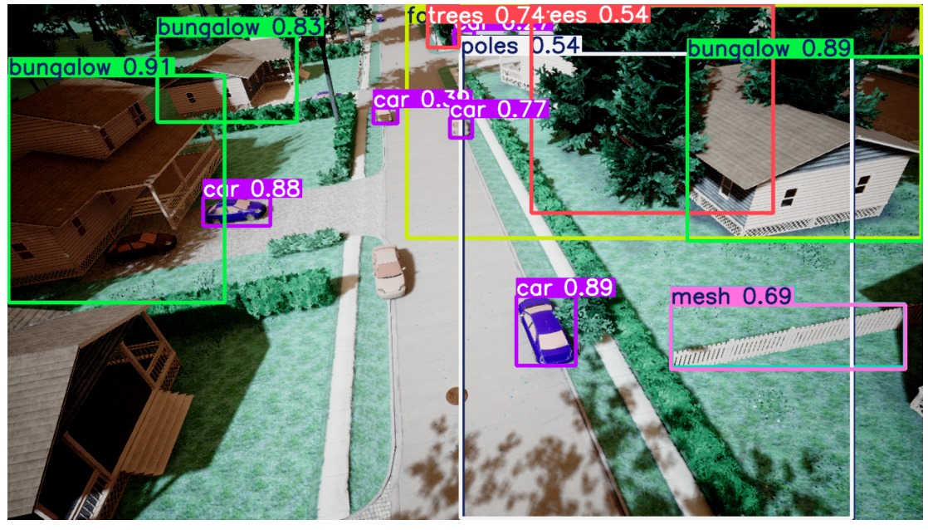
YOLOv11 Model Performance
• mAP@0.5 = 0.859, mAP@[.5:.95] = 0.784
• F1-score = 0.81 @ conf = 0.473
• Top AP classes: forest (0.981), trees (0.978), car (0.961)
• Weak: wires, ultra_thin
• Confusion matrix showed structured misclassification in thin categories.
• Excellent inference speed suitable for real-time use.

Slide 36
Detectron2 Faster R-CNN Performance
• mAP@0.5 = ~0.72, mAP@[.5:.95] ≈ 0.66
• ARm = 0.80, High recall in medium objects
• Accurate under occlusion and lighting changes
• Best AP classes: car, trees, forest
• Weak on ultra_thin, wires
• High confidence scores >0.95 in most detections.

Slide 37
Detectron2 RetinaNet Performance
• mAP@0.5 = 0.76, mAP@[.5:.95] = 0.67
• High recall for small & medium objects: ARs = 0.81
• Strong in urban scenes, tight bounding boxes
• AP: car (88.5), bungalow (78.2), trees (75.2)
• Weak on thin structures
• Balanced speed and accuracy.

Slide 38
RT-DETR (HF) Performance
● mAP@0.5 = 0.695, mAP@[.5:.95] = 0.610
● Strong attention-based localization in complex aerial scenes
• Strong in urban scenes, tight bounding boxes
● Best AP classes: trees, fence, bungalow
• Weak on ultra-thin/pole detection
● Moderate GPU load, real-time capable

Slide 39



Model Comparison Summary
YOLOv11:
• Highest mAP & real-time speed
• Best for dense drone navigation
Faster R-CNN:
• Robust under occlusion
• High medium-object recall
RetinaNet:
• Balanced recall & precision
• Best for structured environments
• Attention-based detection in cluttered scenes • Best for fine-grained, transformer-based localization
RT-DETR (HF):

Slide 40
Metric | YOLOv11 | Faster R-CNN | RetinaNet | RT-DETR (HF)
mAP@0.5 | 0.859 | 0.720 | 0.760 | 0.695
mAP@[0.5:0.95] | 0.784 | 0.660 | 0.670 | 0.610
F1 Score | 0.81 | 0.75 | 0.76 | 0.705
Best Classes (AP) | forest, trees, car | car, trees, forest | car, trees, bungalow | trees, fence, bungalow
Weak Classes (AP) | ultra-thin, wires | wires, ultra-thin | ultra-thin, wires | ultra-thin, poles
AP (small objects) | 0.64 | 0.63 | 0.64 | 0.54
AR (medium objects) | 0.80 | 0.80 | 0.80 | 0.76
Training Stability | High | Moderate | Moderate | Moderate
Visual Accuracy | High | High | High | Medium-High
Model Comparison Table

Slide 41
Improvement: Model Enhancements
🔴 YOLOv11: • Custom anchor tuning • Trained over 450+ epochs • NMS and confidence threshold optimization
🟢 Detectron2 Models (Faster R-CNN, RetinaNet): • Adjusted batch size and learning rate • Trained on COCO-style aerial dataset • Separate hyperparameter tuning for each model
🟣 RetinaNet (Detectron2): • Focal loss effectively addressed class imbalance • Maintained tight bounding boxes in structured environments
🔵 RT-DETR (HF): • Transformer-specific learning rate scheduling • Dense query supervision for better convergence • Required careful batch size tuning to avoid memory overflow
⚙️ All Models: • Cross-model hyperparameter tuning improved generalization • COCOEvaluator and visual diagnostics guided training optimization

Slide 42




Innovation: Architectural Advancements
🧪 YOLOV11: LIGHTWEIGHT, SINGLE-STAGE CNN ARCHITECTURE OPTIMIZED FOR REAL-TIME INFERENCE AND LOW LATENCY.
🖥️ FASTER R-CNN: TWO-STAGE ARCHITECTURE WITH REGION PROPOSALS AND REFINED CLASSIFICATION, ROBUST UNDER OCCLUSION AND CLUTTER.
🧬 RETINANET: SINGLE-STAGE DETECTOR USING FOCAL LOSS TO ADDRESS CLASS IMBALANCE, EFFECTIVE FOR SMALL AND MID-SIZE OBSTACLES.
🧠 RT-DETR (HF): TRANSFORMER-BASED ARCHITECTURE WITH END-TO-END ATTENTION, ELIMINATING NMS FOR PRECISE CONTEXTUAL DETECTION.
🔁 EVALUATION PIPELINE: UNIFIED COCO-FORMAT DATASET AND COCOEVALUATOR ENABLED STANDARDIZED BENCHMARKING ACROSS MODELS.

Slide 43
Model Deployment
🛟 Hosting: Hosted on Hugging Face Spaces using Streamlit for interactive demo and testing.
💻 GPU-backed Deployment: Supports model selection UI and input image caching for smooth inference.
🚁 YOLOv11: Fastest inference, ideal for real-time drone navigation and quick decision-making.
🖥️ Faster R-CNN: Most robust for complex scenes, effective in detecting occluded or overlapping objects.
📐 RetinaNet: Delivers balanced performance and accurate detection in structured environments.
🧠 RT-DETR (HF): Performs well in cluttered scenes using transformer-based contextual reasoning with moderate latency.

Slide 44
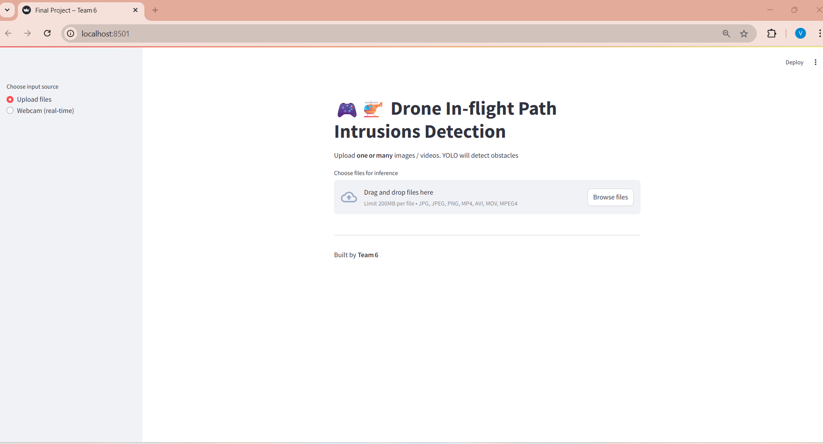
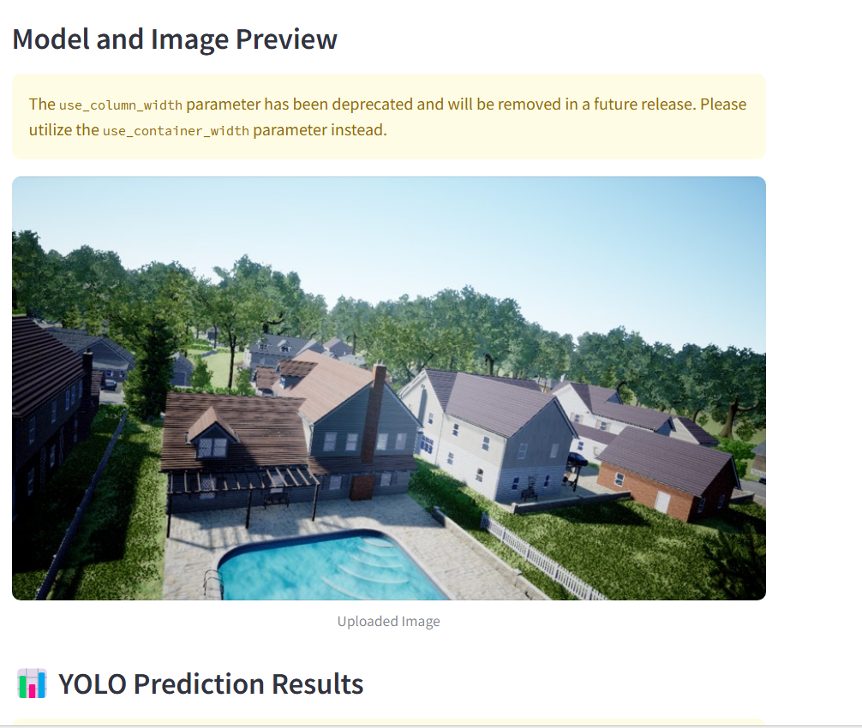
User Interface

Slide 45
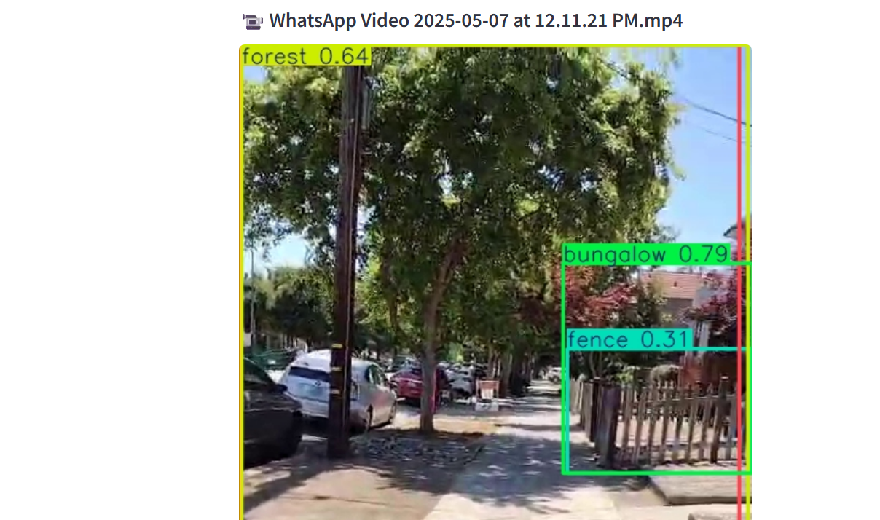
Image & Video Prediction
Image Prediction
Video Prediction

Slide 46
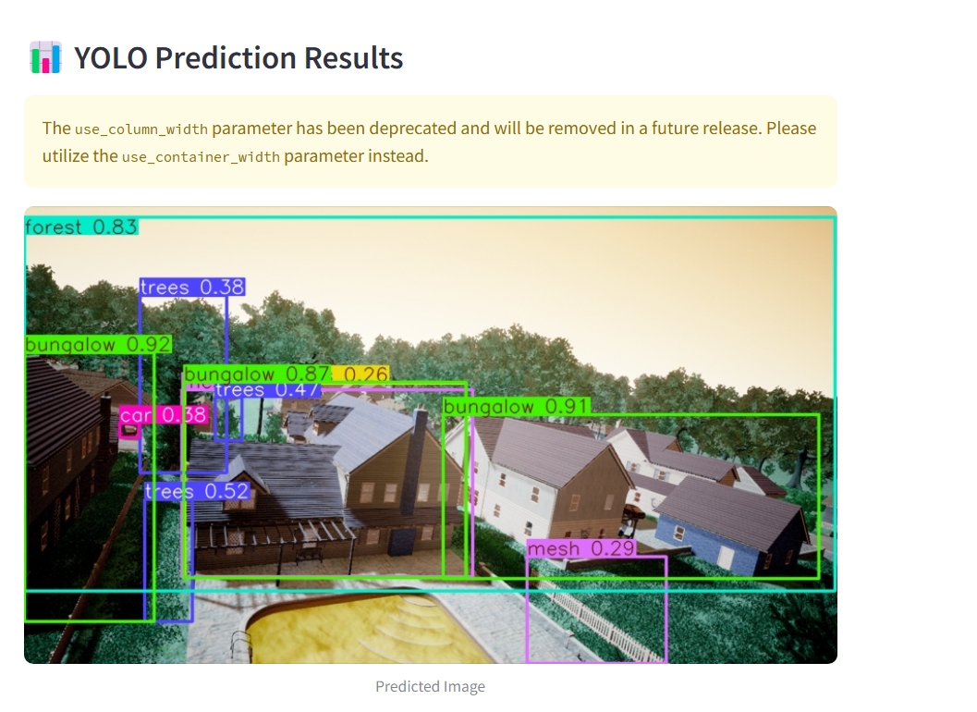
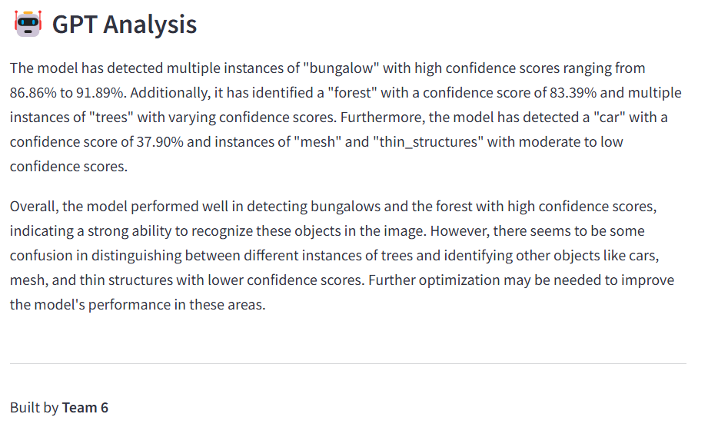
Prediction Results and GPT Analysis

Slide 47
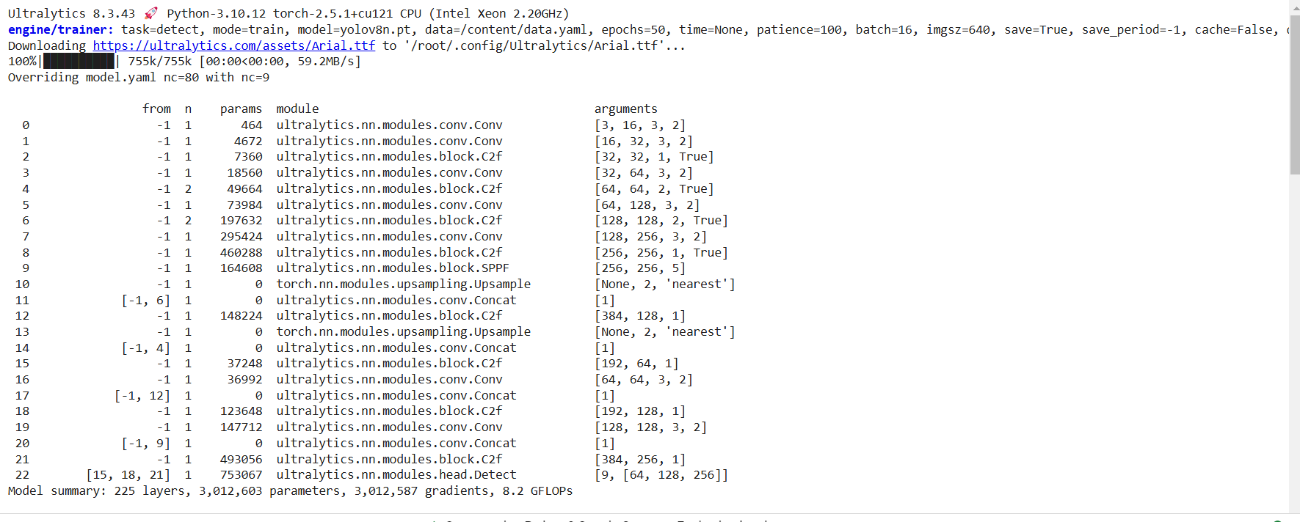
Machine Learning Model Prototyping & Results
Prototyping
On a small subset of images, we utilized a YOLOV11 object detection framework to detect obstacles such as ultra-thin structures, small meshes, and tree branches relevant to drone navigation. The implementation leveraged PyTorch and ultralytics YOLO libraries for model building, training, and evaluation, focusing on robustness and accuracy.
The dataset was preprocessed and annotated to ensure accurate model training, with particular attention given to underrepresented obstacle types to improve detection capability.
Setup: The task is object detection with training for 500 epochs on 640x640 images and a batch size of 16. The model is configured for 11 classes (nc=11).
Architecture: The model consists of 225 layers, including convolutional (Conv), feature-processing (C2f), spatial pooling (SPPF), and upsampling (Upsample) layers, along with a final Detect layer for outputting bounding boxes and class probabilities.
Summary: The model has 3 million parameters and gradients, with a computational cost of 8.2 GFLOPs, optimized for efficient real-time detection tasks.

Slide 48
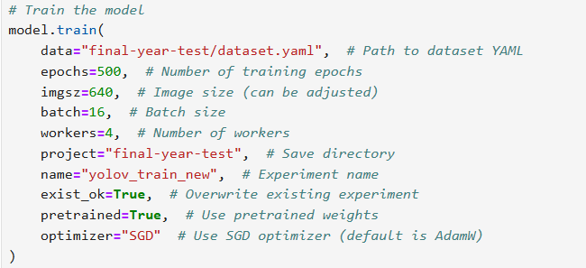
Training Parameters

Slide 49
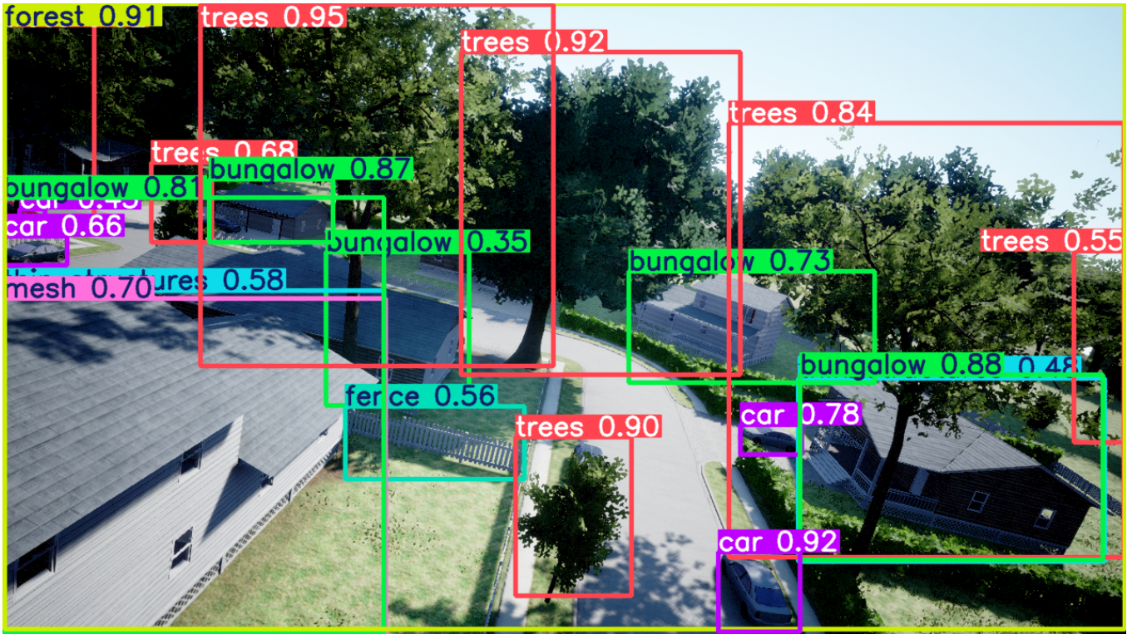
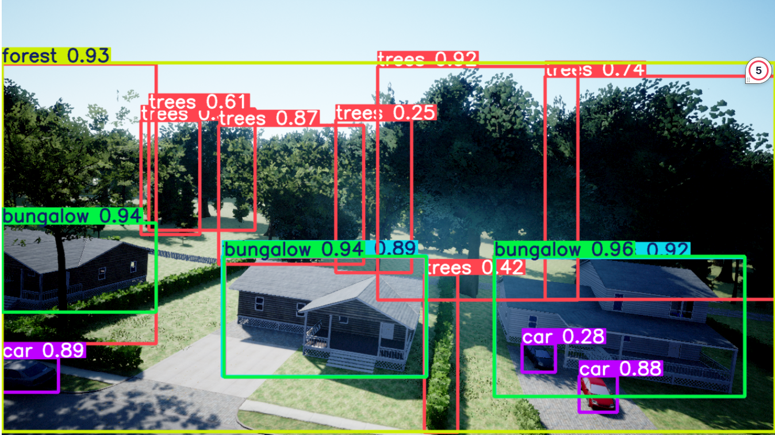
Testing Results

Slide 50
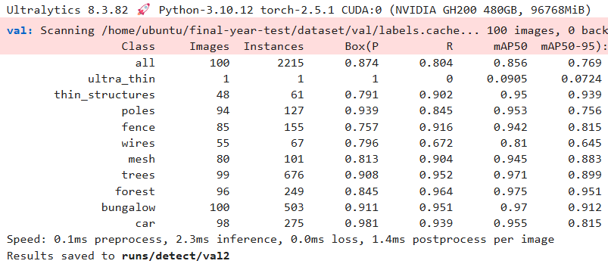
Results & Conclusion: Training and Evaluation Metrics
Key performance metrics achieved on the subset:
Precision: 0.874
Recall: 0.804
mAP50: 0.856
mAP50-95: 0.769

Slide 51
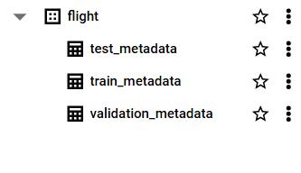
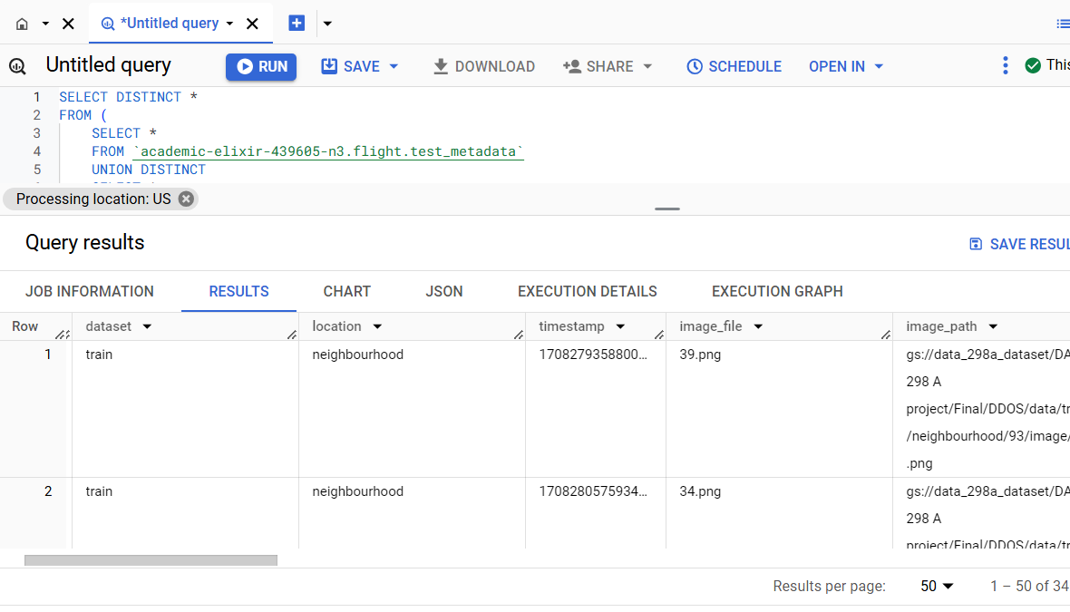
Big Query Results
The images depict a Google BigQuery setup for querying metadata tables (test_metadata, train_metadata, validation_metadata) from a dataset named flight.
The query retrieves distinct entries from combined training and test datasets, with results showing data attributes like location, image_file, image_path, and depth_path for drone-related tasks.

Slide 52
Custom vs Base Model Performance
Metric | YOLOv11 | Faster R-CNN | RetinaNet | RT-DETR
F1-Score (Base → Custom) | 0.74 → 0.81 | 0.70 → 0.75 | 0.71 → 0.76 | 0.68 → 0.705
AP (Small Objects) | 0.53 → 0.64 | 0.48 → 0.63 | 0.49 → 0.64 | 0.45 → 0.54
AR (Medium Objects) | 0.74 → 0.80 | 0.72 → 0.80 | 0.73 → 0.80 | 0.71 → 0.76
YOLOv11 showed the largest improvement in both mAP@0.5 and mAP@[.5:.95], validating its tuning for real-time detection.
Faster R-CNN and RetinaNet gained accuracy after dataset-specific fine-tuning, especially on small/overlapping objects.
RT-DETR had modest but consistent gains, especially in complex scene handling due to dense supervision optimization.

Slide 53
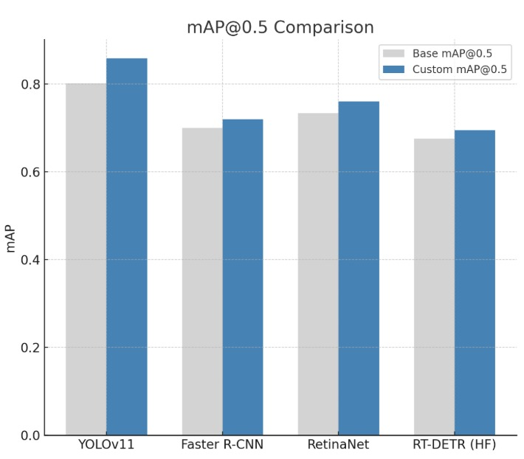
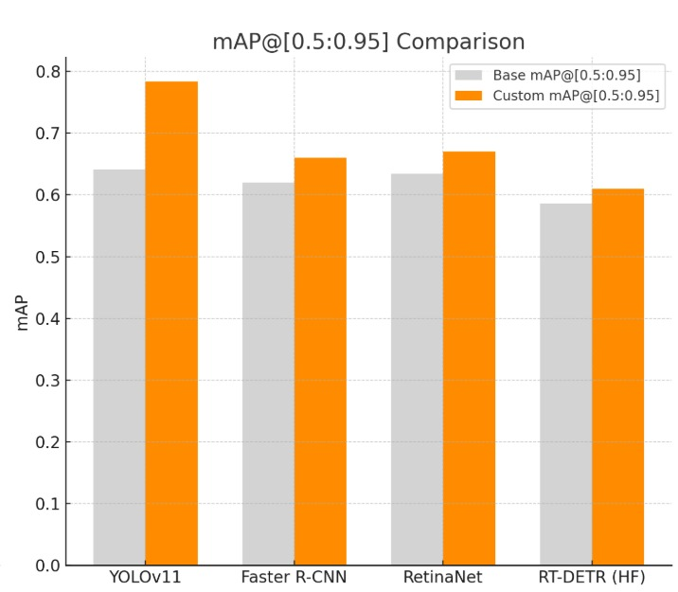
Custom vs Base Model Performance
mAP@0.5 Comparison
YOLOv11 achieved the highest mAP@0.5: 0.865.
Custom-trained RetinaNet and Faster R-CNN saw gains of ~3–6%.
RT-DETR had the lowest mAP but still improved post-tuning.
mAP@[0.5:0.95] Comparison
YOLOv11 saw a +14% boost in custom mAP@[.5:.95].
All models improved after tuning.
RT-DETR had modest gains, indicating potential with further fine-tuning.

Slide 54
Challenges Faced
Class Imbalance:
Underrepresented classes, such as ultra-thin structures and small meshes, were difficult for the model to detect effectively, leading to inconsistencies in predictions.
Limited Dataset Size:
Training on a small subset of images constrained the model’s ability to generalize, impacting performance on diverse and complex obstacle types.

Slide 55

Project Summary: Real-Time Drone Obstacle Detection System
🚁 Goal
Develop a system for real-time obstacle detection to enhance drone safety and navigation.
🧠 Models Used
YOLOv11 – Fastest inference, ideal for real-time use
Faster R-CNN – Strong with small/occluded objects
RetinaNet – Balanced speed and accuracy
RT-DETR (HF) – Best in complex, dynamic environments
📊 Evaluation Metrics
Precision, Recall, F1-score, mAP@[0.5:0.95]
🛠️ Pipeline Highlights
Complete workflow: data ingestion → preprocessing → model training/testing → deployment
Deployed via Google Cloud + REST APIs
Interactive UI built with Streamlit
✅ Outcome
Built a deployable, accurate system combining strengths of multiple models—laying the groundwork for future drone AI applications.

Slide 56



Key Benefits
Multi-model architecture:
Complete pipeline:
Scalable & modular:
YOLOv11 & RT-DETR → Fast, real-time detection
Detectron2 & Faster R-CNN → Higher accuracy for small/overlapping obstacles
Covers data preprocessing, training, evaluation, deployment
Integrated with REST APIs, Google Cloud, and Streamlit
Easily extendable for future model upgrades

Slide 57



Shortcomings
Resource usage:
Models like Faster R-CNN are compute-intensive, limiting use on lightweight drones
Speed vs. accuracy trade-off:
High-precision models often have slower inference times
Environment sensitivity:
Real-world performance may vary with lighting, weather, and camera quality

Slide 58

System & Model Applications
🚨 Disaster Response
Drones can monitor floods, forest fires, or structural collapses
Helps emergency teams assess damage and locate survivors without risk to personnel
🏗️ Infrastructure Inspection
Detects cracks, cables, and minor structural faults on buildings, bridges, and power lines
Models like Faster R-CNN and Detectron2 excel at identifying small and overlapping features
🚚 Autonomous Delivery & Navigation
Enables drones to avoid trees, wires, and urban obstacles in real time
Powered by YOLOv11 and RT-DETR for fast, accurate detection
🛡️ Security & Surveillance
Identifies people, vehicles, and suspicious activity near sensitive or restricted zones
Effective across indoor and outdoor scenarios
🌱 Environmental Monitoring & Research
Supports tracking of wildlife, vegetation, and land conditions
Useful for conservation, agriculture, and field-based data collection
📦 Key Advantage
Modular, adaptive system supports multiple use cases in both controlled and dynamic environments

Slide 59
Lessons Learned
🧠 Full-System Development
Covered all stages: data prep, model training, deployment, and UI integration
Faced challenges in handling large image sets and fine-tuning deep models
🎯 Model Choice Matters
YOLOv11 excelled in real-time use
Faster R-CNN & Detectron2 worked better in dense, complex scenes
Balancing speed vs. accuracy was essential
🧩 Modular Design Helped
Separating tasks (training, backend, UI) made development more efficient
Easier integration and testing
🤝 Planning & Coordination
Structured teamwork was key to building a scalable, aligned system

Slide 60




Recommendations for Future Work
IMPROVE DETECTION ACCURACY
OPTIMIZE FOR EDGE DEPLOYMENT
ENHANCE ENVIRONMENTAL ADAPTABILITY
ENABLE CONTINUOUS LEARNING

Slide 61
Contributions & Societal Impact
🛟 Safety & Emergency Response
Helps drones navigate dangerous areas
Supports rescue, damage assessment, and supply delivery
🏗️ Monitoring & Maintenance
Automates inspections of bridges, power lines, remote sites
Reduces costs and improves efficiency in critical sectors
🎓 Research & Education
Demonstrates real-world AI applications
Provides a foundation for scalable, impactful robotics projects

Slide 62
Team Roles and Contributions (Balanced Distribution)
Role | Team Member | Key Responsibilities | Slide Contributions
Modeling & Deployment | Harsh Somaiya | - Lead on YOLOv11 training, tuning, and evaluation - Assist with REST API integration and Streamlit UI - Co-author deployment slides and metrics | - YOLOv11 Performance - Deployment Slide - Inference Speed, Latency & Memory Analysis
Data & Evaluation | Akshay Sodha | - Handle data preprocessing & augmentation - Lead RetinaNet training & evaluation - Co-author evaluation and model comparison content | - Data Engineering - RetinaNet Performance - Evaluation Metrics & Comparison Tables
Architecture & Documentation | Vansh Sharma | - Lead RT-DETR model integration & attention tuning - Support deployment pipeline - Draft project summary and technical overview slides | - RT-DETR Slide - Workflow Diagram - Project Summary & Future Work
Integration & Presentation | Tanvi Pagrut | - Lead Faster R-CNN modeling & tuning - Oversee backend-to-UI pipeline - Design and narrate impact, lessons, and societal contribution slides | - Faster R-CNN Slide - System Demo & Pipeline Slide - Societal Impact, Lessons Learned, Contributions Slide

Slide 63
Thank You

